Slide 1
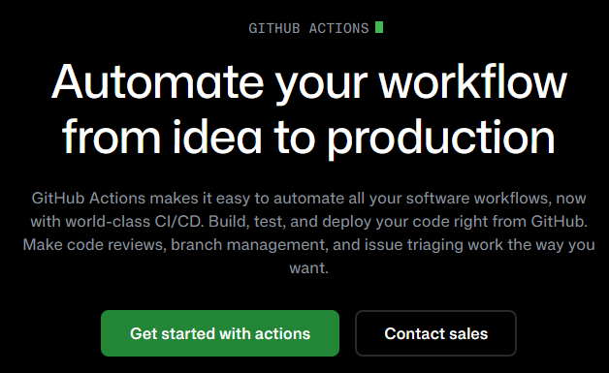
GITHUB ACTIONS

Slide 2
GitHub Actions is a built-in automation tool that helps you automate workflows directly inside your GitHub repository.
GitHub Actions lets you create workflows that run when specific events happen.
Example events:
push (when you push code)
pull request
schedule (cron jobs)
Workflows are defined using YAML files.

Slide 3
Create this folder inside your repository:
.github/workflows/
Then create a file like:
.github/workflows/ci.yml

Slide 4
name: Run Pytest
on:
push:
branches:
- master
pull_request:
branches:
- master

Slide 5
jobs:
test:
runs-on: ubuntu-latest
steps:
- name: Checkout repository
uses: actions/checkout@v4
- name: Set up Python
uses: actions/setup-python@v5
with:
python-version: '3.11'
- name: Install dependencies
run: |
python -m pip install --upgrade pip
pip install -r requirements.txt
pip install httpx
pip install pytest
- name: Run tests
run:
pytest

Slide 6
name → Workflow name
on → When it runs
jobs → Tasks to perform
runs-on → Virtual machine OS
steps → Individual actions

